Slide 1
Co-cure Process
of
Honeycomb Sandwich Structures

Slide 2
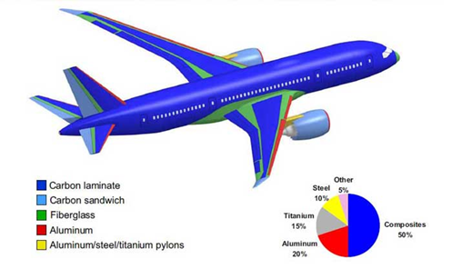
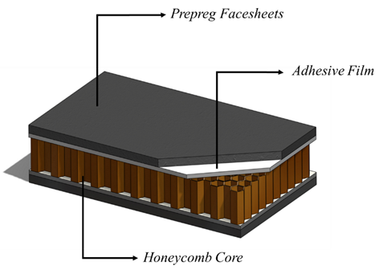
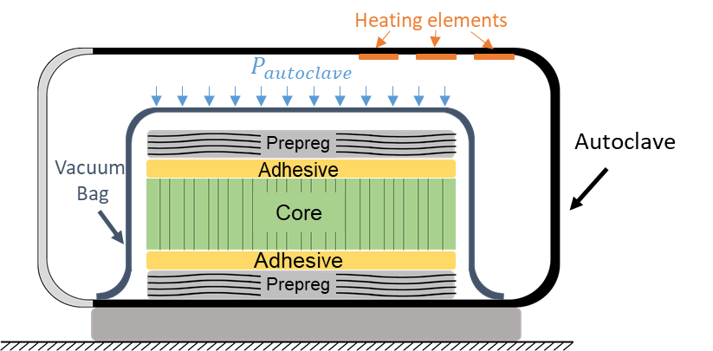
Process Description
Sandwich structures are light and stiff. Because of these characteristics, sandwich structures are popular in aerospace structures (e.g., airplane fuselage).
In the co-cure process, the honeycomb core sandwich structure consists of prepreg facesheets on both sides of honeycomb core and a layer of adhesive in between, is placed under a vacuum bag inside the autoclave where the facesheet consolidation and the bonding occur simultaneously in a single operation under a prescribed co-cure cycle.
The cure of different materials adjacent to each other in the sandwich structure layup, makes the process susceptible to higher defect levels such as poor consolidation and a high level of porosity.
In this challenge, you are going to discover the relationship of different physical phenomena in the co-cure process and build a data-driven tool to predict the facesheet consolidation and bond-line porosity in a co-cure process, and implement an optimization model in the tool to find the best cure cycle for the objective function.

Slide 3





$$Ramp 1$$
Duration
$$Ramp 2$$
D$uration$
$$Temperature$$
$$Dwell 2$$
Cure Cycle and Process Parameters
$$Heat Rate 2$$
$$Temperature$$
$$Dwell 1$$
$$Heat Rate 1$$
The cure cycle in the co-cure process is represented by the pressure and temperature applied within the autoclave and the pressure inside the vacuum bag as a function of time.
It is common that the cure cycles contain two temperature ramps and temperature dwells. However, cure cycles with only one temperature ramp can be used to cure the materials as well.
In the provided data set, the pressure cycles in the Autoclave and Vacuum bag are described by the pressure, the time we start applying the pressure and the duration of it.
Therefore, the cure cycles are defined as:
$$AutoclaveStart Time$$
$$Autoclave Pressure$$
$$Vacuum Start Time$$
$$Vacuum Pressure$$

Slide 4
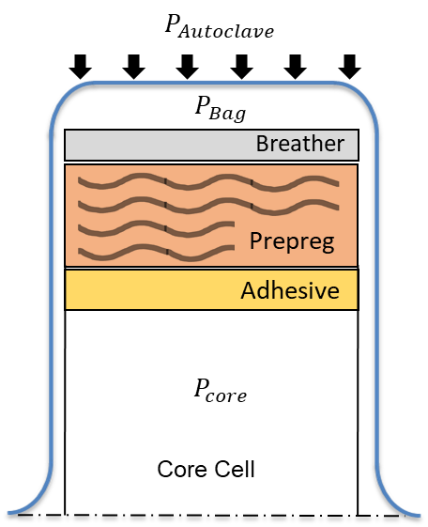
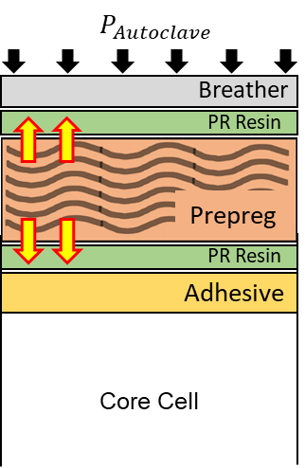
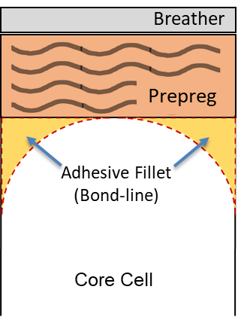
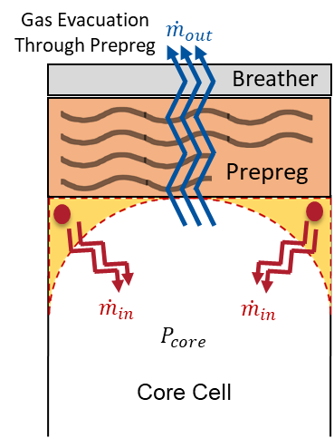
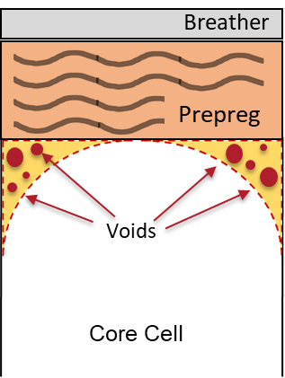
Physical Processes
(A)
(B)
During co-cure process of sandwich structures, different phenomena occur simultaneously:
(A) Prepreg Facesheet Consolidation
(B) Bond-line Fillet Formation
(C) Bond-line Porosity Development
(D) Core Pressure Evolution
In your final presentation, you must
find the governing process parameters for each phenomenon,
understand the interactions of different phenomena in the co-cure process,
based on the data set and explain the reasoning for your claim.
You are suggested to read the provided papers in the reference for more information.
Resin Bleeding
Consolidation
Resin Bleeding
(C)
(D)

Slide 5
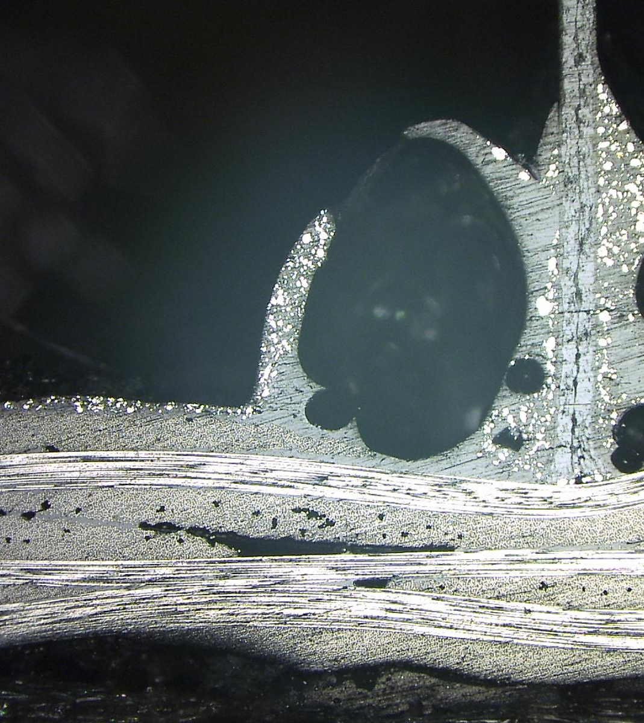
Data Set and Output Parameters
High Porous Bond-line
Porous Free Bond-line
As the bond-line consists of both adhesive and prepreg facesheets squeezed out resin, porosity has been reported in different parameters as
Adhesive (AD) Porosity (ii) Prepreg (PR) Porosity (iii) Effective(Eff) Porosity.
The Effective porosity that is the total porosity of the bond-line is the parameter which is known as the bond-line porosity.
In this process, under high temperature and low vacuum pressure, the adhesive and resin may turn into foam. Therefore, facing high porosity of more than 60%) within the bond-line is possible because in such cases, voids can get large and entrapped by highly viscous liquid (Look at the difference of the fabricated samples in the micrographs). The format of the porosity in the data set is percentage.
The Fiber volume fraction shows the consolidation level of the facesheet. In reality, the fiber volume fraction changes across the facesheet. However, in the provided data set, the reported parameter for the consolidation level is the maximum of fiber volume fraction across the facesheet. The format of this parameter is percentage as well.
The Volume of Adhesive and the squeezed-out resin from prepreg helps you to understand the concept of effective porosity. These volumes may help you to predict the outputs of the process simulation.
The provided 1800 data set in this challenge, that are generated based on [1,2,4,5], are in the following format:

Slide 6

Student Challenge Objectives
As described in the challenge description, you are expected to implement machine learning methods on the provided data set to
find the governing process parameters in each phenomenon.
understand the interactions of different phenomena in the co-cure process.
build a tool, based on the provided data, to design new cure cycles and to predict the facesheet consolidation level and bond-line porosity of the co-cured sandwich structure.
implement an optimization model in the tool to find the best cure cycle for your assumed objective function. The objective function must include at least two of the following parameters: (a) Facesheet consolidation level (b) Bond-line porosity (c) Total time of the cure cycle (Including more parameters in the objective function is a plus). In other words, you must introduce a cure cycle that contain the highest possible consolidation level and lowest bond-line porosity in the shortest cure cycle.

